Slide 1
Ajax - Introduction

Slide 2
Why Ajax?
Read data from a web server - after the page has loaded
Update a web page without reloading the page
Send data to a web server - in the background

Slide 3
Example
<!DOCTYPE html>
<html>
<body>
<div id="demo">
<h2>The XMLHttpRequest Object</h2>
<button type="button" onclick="loadDoc()">Change Content</button>
</div>
<script>
function loadDoc() {
const xhttp = new XMLHttpRequest();
xhttp.onload = function() {
document.getElementById("demo").innerHTML =
this.responseText;
}
xhttp.open("GET", "ajax_info.txt");
xhttp.send();
}
</script>
</body>
</html>
Notes:
The HTML page contains a <div> section and a <button>.
The <div> section is used to display information from a server.
The <button> calls a function (if it is clicked).
The function requests data from a web server and displays it:

Slide 4
What is Ajax?
AJAX = Asynchronous JavaScript And XML.
AJAX is not a programming language.
AJAX just uses a What is AJAX?
AJAX just uses a combination of:
A browser built-in XMLHttpRequest object (to request data from a web server)
JavaScript and HTML DOM (to display or use the data)
AJAX allows web pages to be updated asynchronously by exchanging data with a web server behind the scenes. This means that it is possible to update parts of a web page, without reloading the whole page.

Slide 5
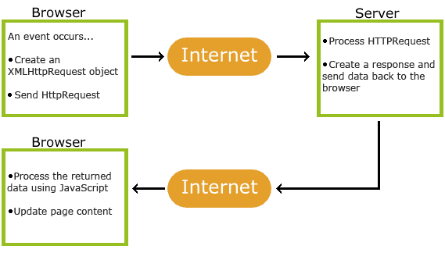
How Ajax works
1. An event occurs in a web page (the page is loaded, a button is clicked)
2. An XMLHttpRequest object is created by JavaScript
3. The XMLHttpRequest object sends a request to a web server
4. The server processes the request
5. The server sends a response back to the web page
6. The response is read by JavaScript
7. Proper action (like page update) is performed by JavaScript

Slide 6
AJAX - The XMLHttpRequest Object
The keystone of AJAX is the XMLHttpRequest object.
Create an XMLHttpRequest object
Define a callback function
Open the XMLHttpRequest object
Send a Request to a server
Example:-
// Create an XMLHttpRequest object const xhttp = new XMLHttpRequest(); // Define a callback function xhttp.onload = function() { // Here you can use the Data } // Send a request xhttp.open("GET", "ajax_info.txt"); xhttp.send();
Notes:
All modern browsers support the XMLHttpRequest object.
The XMLHttpRequest object can be used to exchange data with a web server behind the scenes. This means that it is possible to update parts of a web page, without reloading the whole page.

